Slide 1
Online Edu. Employment
-
-
Team VEL
07 Oct. 2015
Notes:
Good afternoon everyone, we are the VEL team. I am Shawn, who is the scrum master in this week.
Our project is to re-develop a currently existing online education employment website for Getskills company.
Initially, there is a little trouble because the platform is changed from Android to website, where the team has very limited experience.

Slide 2
1. Development Plan
Initialization
Design
Sprint01
Sprint02
Final Presentation
Notes:
However, it doesn't matter since we apply agile and lean.
Our team learned required technology quickly and made a detail development plan.
Now we are in the last stage and everything goes well.

Slide 3
2. Project Achievement
100% of the initial product backlog is implemented over sprint01
100% of the additional product backlog is completed by sprint02
Notes:
Do you remember that in the prototype presentation we proudly stated that all the user stories in the initial product backlog have been completely finished and our customers are pretty satisfied.
Therefore, the main goal in the second sprint is to refine our product based on the feedbacks we got. We expanded the product backlog and achieved all the user stories, again.

Slide 4
3. User Stories (Sprint 2)
Homepage polish
Test automation page
Contact us integration
Dynamic Team profile
New success stories List
Research on Google searching strategies
Notes:
Let me list these user stories in sprint 2
As you see, totally there are 6 user stories. The purple mark means this item is a refinement task; the yellow mark implies it is new added page or function; the black mark means it is an integration task with the Legacy system; and the last white one, which I think it is the most interesting part, it is to provide some strategies to make the website stand out from google searching because it is a real project. We also write a report about this.

Slide 5
4. Homepage Polish
Change layout to present information more efficiently
Add visitor counter for statistics
Add Contact us link
Cut the height of main image on phone view

Slide 6
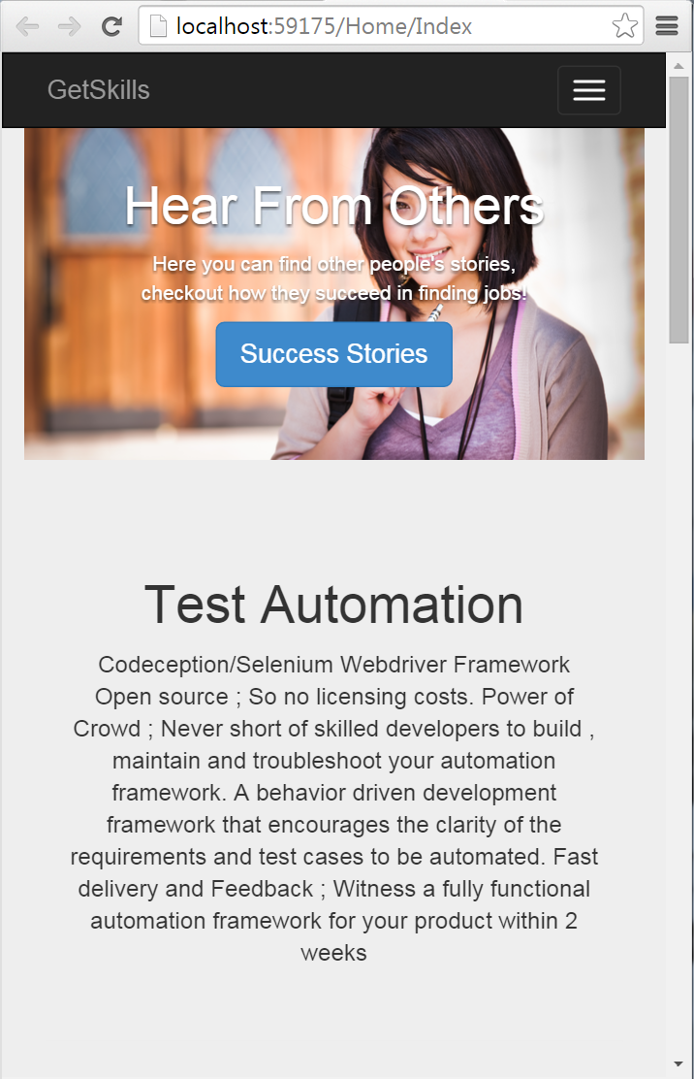
5. Mobile Friendly
Previously the image will take over the whole page
Now we add screen detection control to increase mobile user experience

Slide 7
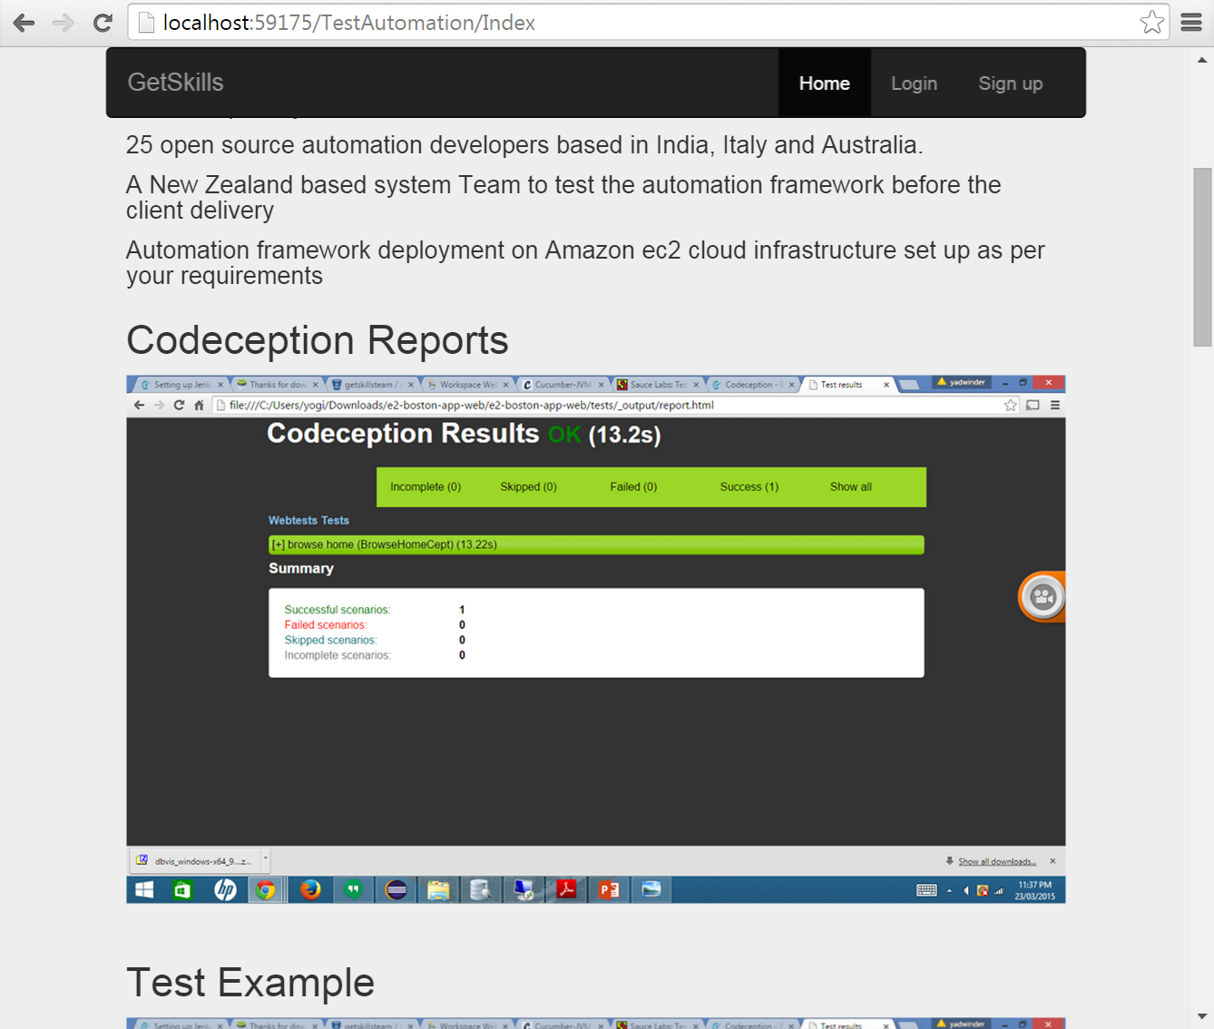
6. Test Automation

Slide 8
7. Team Profile
Client view
Client view page
Admin function
List page
Add page
Edit page
Delete page

Slide 9
8. Test for Team Profile
Unit: case

Slide 10
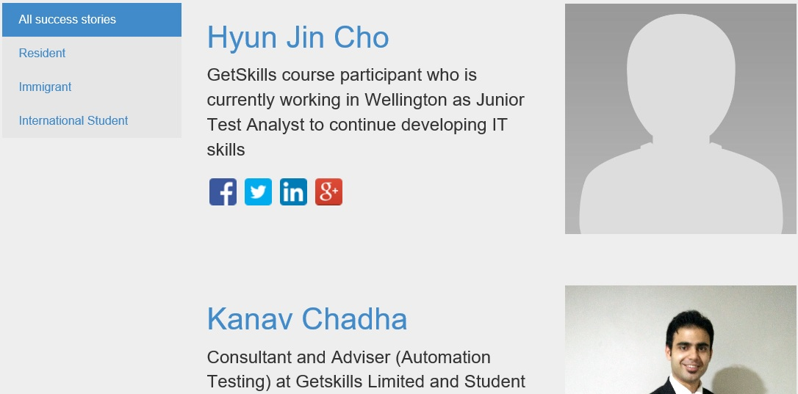
9. Success Story
Finalised Success Story Categories
Real time data incorporated in the DB
Dynamic data / Real-time data is used in Success Stories, depending upon the user selection
Social Media links added to the GetSkills alumni.

Slide 11
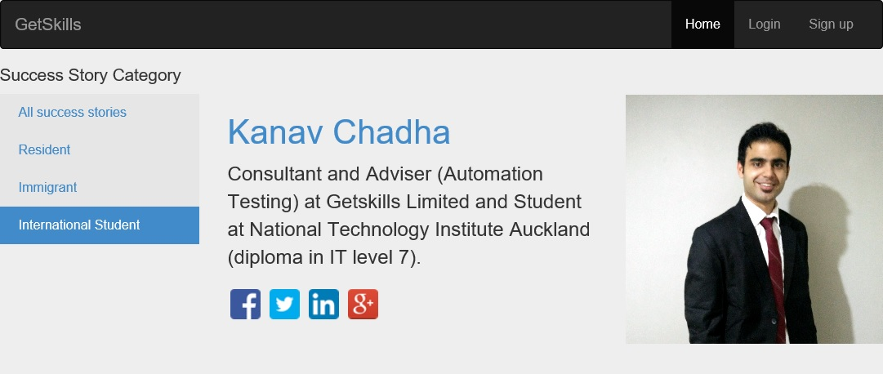
– Detail view
10. Success Story Category
Detail view of Success Story is Dynamic / Real time data.
Social Media links added to the Alumni.

Slide 12
11. Future Enhancements
In future an app can be developed, that contains details about GetSkills, which can be added to GetSkills website and visitors can download the same
HR module for GetSkills employees can be developed in future.

Slide 13
Q&A

